Slide 1

Abstract Review System
ICT

Slide 2

Database Scope
The purpose of this database system is to have an automated process for abstracts and posters submissions in order to receive approval. The system must be able to assign abstracts to reviewers and provide a friendly GUI for users to handle submission and approval.
Student
Faculty
Admin
2

Slide 3

Abstract Review System
Report Requirements
Interface
Corrections
Database Design-
ER Diagram
Testing
Final System
3
Notes:
1- Identify the Report requirements, analyze our current database design
2- Re-design the database to meet all our requirements
3-Until the database design is correct, we can work on the interface (forms)
4-Database and new updates on interface are tested in the waterbeta
5-Make Corrections
6- Deploy into production

Slide 4
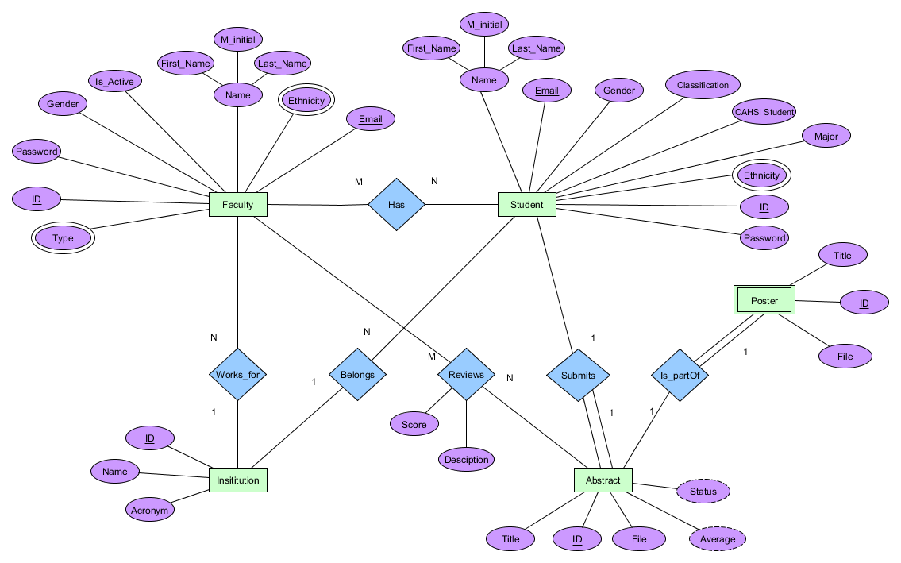
Entity Relational Diagram
4

Slide 5
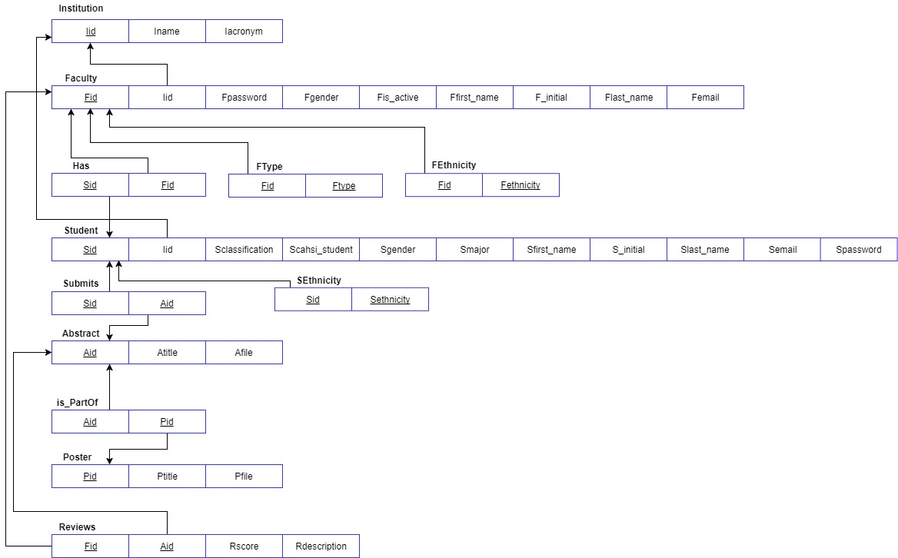
Relational Model
5

Slide 6
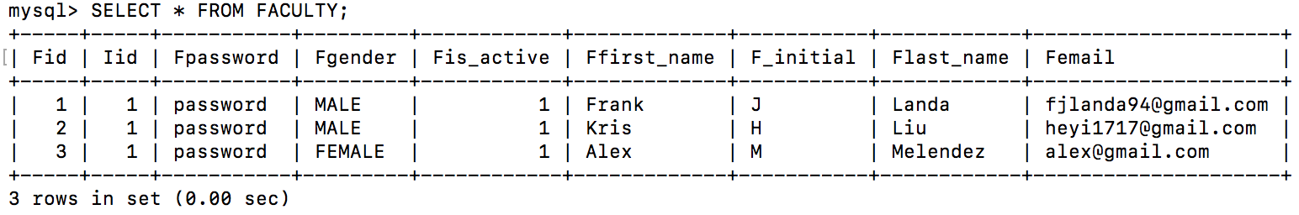
Database Schema in MySQL
CREATE TABLE FACULTY (
Fid INT(10) NOT NULL AUTO_INCREMENT,
Iid INT(10) NOT NULL,
Fpassword VARCHAR(255) NOT NULL,
Fgender VARCHAR(255) NOT NULL,
Fis_active BOOL NOT NULL,
Ffirst_name VARCHAR(255) NOT NULL,
F_initial VARCHAR(255) NOT NULL,
Flast_name VARCHAR(255) NOT NULL,
Femail VARCHAR(255) UNIQUE NOT NULL,
PRIMARY KEY(Fid),
FOREIGN KEY (Iid) REFERENCES INSTITUTION (Iid) ON UPDATE CASCADE ON DELETE CASCADE
)ENGINE = InnoDB;
6

Slide 7
Views & Reports
Faculty, Students & Admin
7

Slide 8
📖
STUDENT
FACULTY
View Applications
View Files to Review
View Applications
Reports
List of all students and their mentors
Count of Abstracts by Institution
Show Active Faculty
List of all Students and Abstract Information
Count of Students by Gender
Count of Students by Ethnicity
8

Slide 9
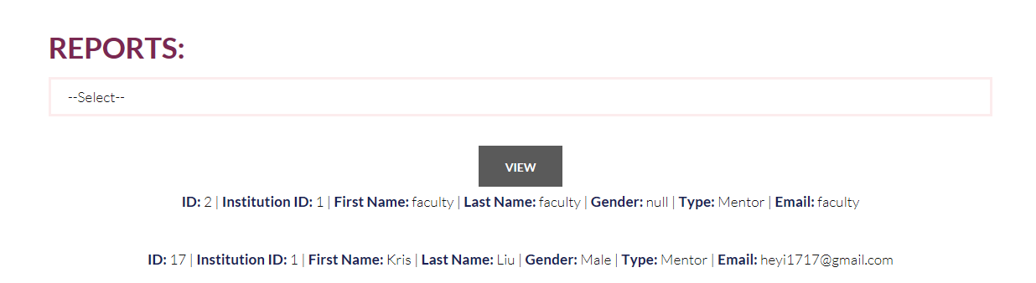
SQL for Reports
Report 1: Show active Faculty information
SELECT * FROM FACULTY JOIN FTYPE WHERE FACULTY.Fid =
FTYPE.Fid AND FTYPE.Ftype = ‘Faculty type1’ AND FACULTY.Fis_active =
1;
ORDER BY FACULTY.Fid;
9

Slide 10
Procedures & Triggers
Procedure: Create a procedure to display the amount of students per institute
Trigger: Create a trigger to add the student id and the mentor id to the HAS table every time a student is added
10

Slide 11
Interface- Demo
11

Slide 12
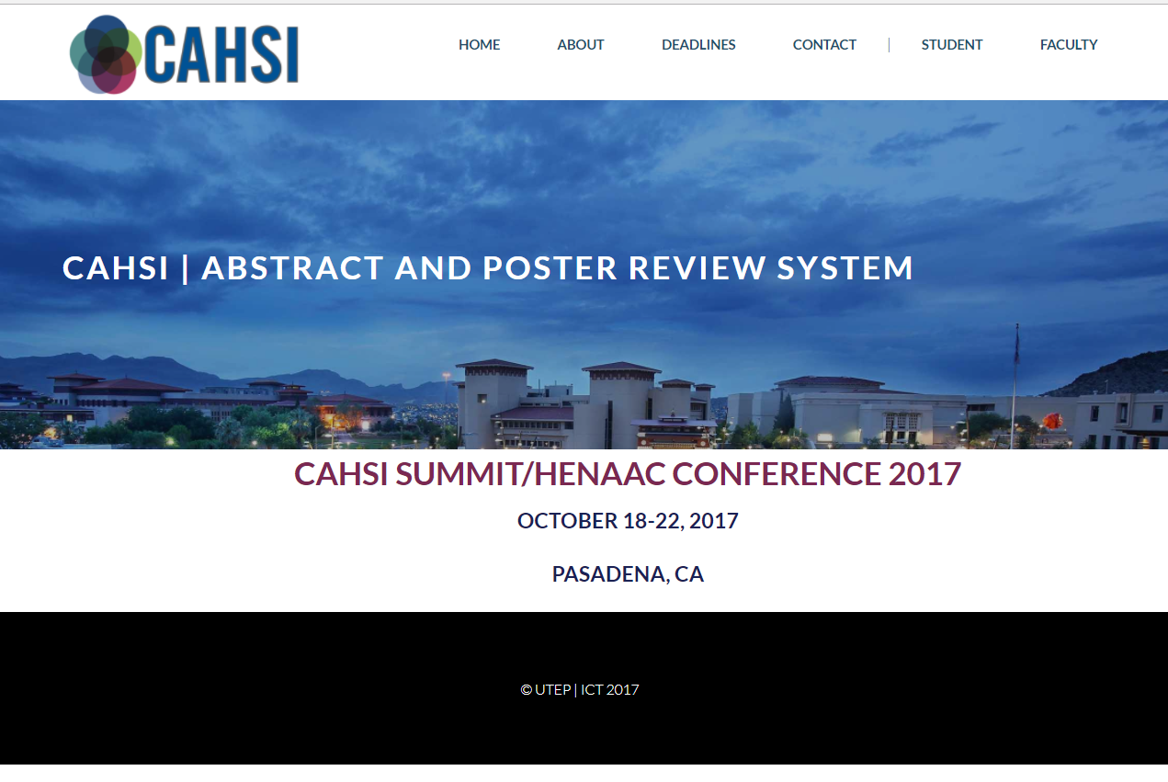
CAHSI
Abstract Review System
http://cs4342.cs.utep.edu/Team10/index.php
12

Slide 13
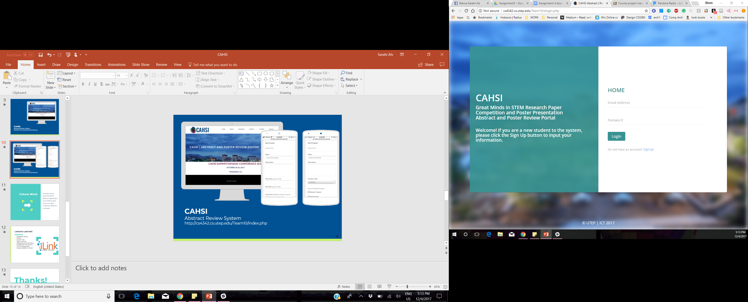
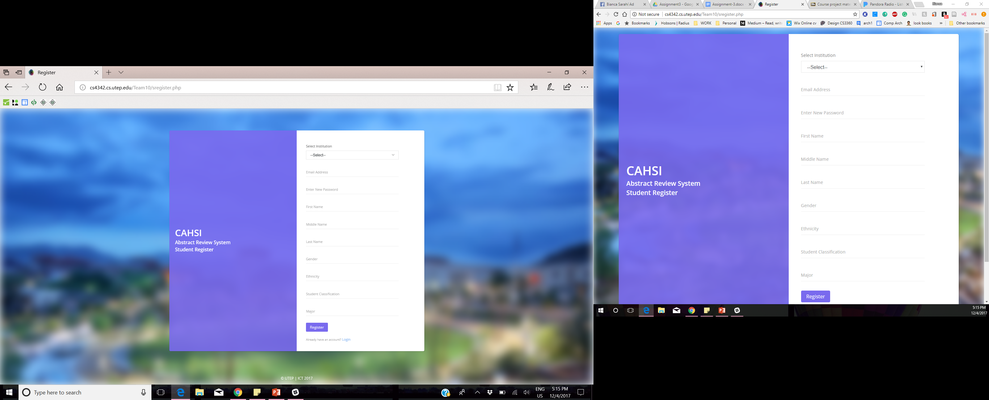
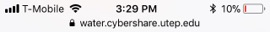
Registration
13

Slide 14
Future Work
Add a profile section for the users
Integrate an automate system to manage deadlines and emails
14

Slide 15
Lessons Learned
Database Design
MySQL
SSH clients
Team working
Database Documentation
PHP
Time management
CS 4342
15

Slide 16
Thanks!
Any questions?
16

Slide 17
Acknowledgements
The Computing Alliance of Hispanic-Serving Institutions (CAHSI)
National Science Foundation: NSF
Dr. Villanueva Rosales- Database Management Instructor
17

